Slide 1
Finishing up Host provisioning Part 3
Finishing initial Cobbler Installation

Slide 2

XSEDE
XSEDE is a single virtual system that scientists can use to interactively share computing resources, data and expertise. People around the world use these resources and services — things like supercomputers, collections of data and new tools — to improve our planet.
Please go to https://www.xsede.org/ and register
After you register, send me your XSEDE ID so I can add you to our project

Slide 3
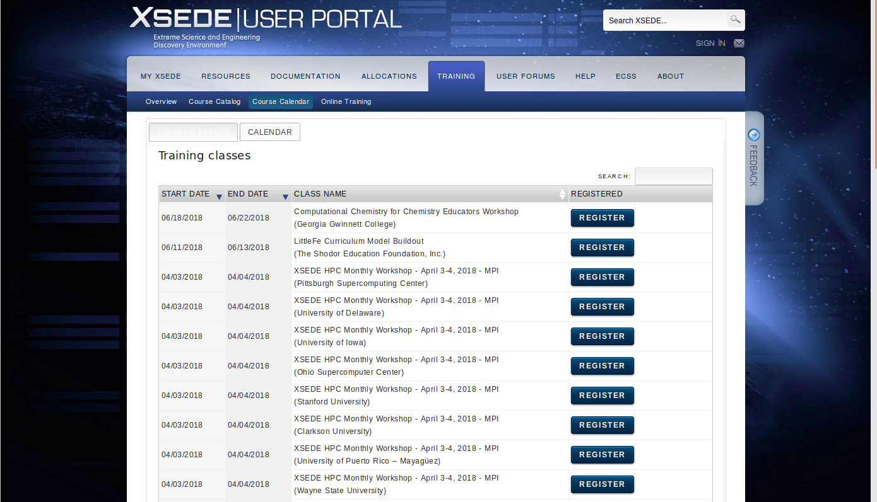
https://portal.xsede.org/course-calendar

Slide 4
More fun with re-direction
Try some more commands:
student> cat /etc/shadow > /tmp/cat-shadow student> cat /tmp/cat-shadow student> cat /etc/shadow 2> /tmp/shadow student> cat /tmp/cat-shadow student> cat /etc/shadow /etc/issue > /dev/null student> cat /etc/shadow /etc/issue 2> /dev/null student> cat /etc/shadow /etc/issue > /dev/null 2>&1

Slide 5
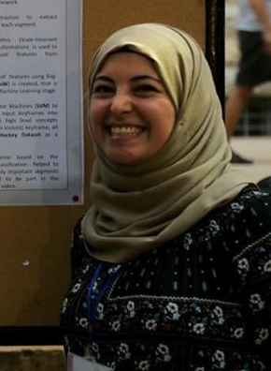

Clicker question:
What is the output from: student> cat /etc/shadow /etc/issue > /tmp/file1 2> /tmp/file2
Both files are empty
file1 has contents of /etc/issue, file2 is empty
file1 has contents of /etc/issue, file2 has error message
file1 has error message, file2 has contents of /etc/issue
I have no idea

Slide 6
Today:
We are going:
Finish the Cobbler Server installation
Boot the Cobbler Client
Do an overview of the kickstart file
We should all share and help each other understand.
Two of your classmate worked on scripting part of the configuration.
Will you share with the class what you did?

Slide 7
There is a new version of htcXXX.ks
A number of problems were found in the original htcXXX.ks
Please get the newer version from the server htc180.najah.edu

Slide 8


It important for me to understand how you are progressing
If I gave you 10 computers, do you think you could create a Cobbler Server and distribute the operating system to the other 9 Clients?
How about 20 computers? 100 Computers?
This is the goal.

Slide 9
Two new Linux Commands
sed - Stream editor for filtering and transforming text
awk - Pattern scanning and processing language
These are higher level commands than the ones we have been learning.
They both can be used for command line text processing
find [options] start-point [expressions] Example:find /usr/bin find /usr/bin -name passwd find /usr/bin -name ‘*wd*’
grep [OPTIONS] PATTERN [FILE...]
Example: grep student /etc/passwd grep student /etc/*
WARNING: Using grep on non-ASCII files can print control characters to the screen
grep -a a /usr/bin/passwd

